Slide 1
Hadoop
Advanced

Slide 2
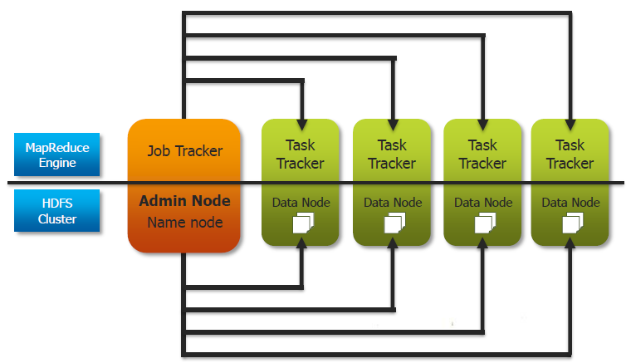
Hadoop Components

Slide 3
HDFS – Rack Awareness <Advanced>
Each block is replicated on three different nodes as follows:
First copy is kept on a node X on Rack A suppose.
Second copy is kept on a node Y on Rack B.
Third copy is kept on a node Z on Rack B.
This is followed because if Rack A fails then it does not happen so that all the replicas of the block are lost since all copies were on same rack.
Also, in order to reduce latency while re-replicating blocks between nodes Y and Z (in case one fails), there is not much latency involved of crossing rack-boundary.

Slide 4
NameNode Concepts And Checkpointing <Advanced>
Namenode keeps metadata
directory tree
file permissions
mapping of files to block IDs
Two constructs are used
fsImage
Edit logs

Slide 5
NameNode Concepts And Checkpointing <Advanced>
fsImage : The fsimage is a file that represents a point-in-time snapshot of the filesystem’s metadata
Very efficient to read
Unsuitable for making small incremental updates like renaming a single file
The NameNode records the modifying operation in the edit log for durability

Slide 6
NameNode Concepts And Checkpointing <Advanced>
A typical edit ranges from 10s to 100s of bytes, but over time enough edits can accumulate to become unwieldy
it can fill up all the available disk capacity on a node
a large edit log can substantially delay NameNode startup
NameNode reapplies all the edits

Slide 7
NameNode Concepts And Checkpointing <Advanced>
Checkpointing is a process that takes an fsimage and edit log and compacts them into a new fsimage
instead of replaying a potentially unbounded edit log, the NameNode can load the final in-memory state directly from the fsimage

Slide 8
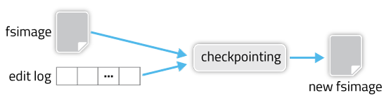
NameNode Concepts And Checkpointing <Advanced>

Slide 9
NameNode Concepts And Checkpointing <Advanced>
Creating a new fsimage is an I/O- and CPU-intensive operation
sometimes taking minutes to perform
During a checkpoint, the namesystem needs to restrict concurrent access from other users
Rather than pausing the active NameNode to perform a checkpoint, HDFS defers it to either the SecondaryNameNode or Standby NameNode

Slide 10
Secondary NameNode<Advanced>
NameNode startup process
Read fsImage in memory
Replay edit logs to create fresh fsImage
Connect to Data Nodes
Exit safe mode
Replaying edit logs is time consuming, if large
Secondary NameNode takes care of the housekeeping periodically

Slide 11
NameNode Concepts And Checkpointing <Advanced>
checkpointing is triggered by one of two conditions
if enough time has elapsed since the last checkpoint (dfs.namenode.checkpoint.period)
if enough new edit log transactions have accumulated (dfs.namenode.checkpoint.txns)
checkpointing node periodically checks if either of these conditions are met
kicks off the checkpointing process

Slide 12
NameNode Concepts And Checkpointing <Advanced>
2NN checks whether either of the two preconditions are met: elapsed time since the last checkpoint or number of accumulated edits.
In the absence of a shared edit directory, the most recent edit log transaction ID needs to be queried via an explicit RPC to the NameNode (NamenodeProtocol#getTransactionId).
2NN triggers an edit log roll, which ends the current edit log segment and starts a new one. The NN can keep writing edits to the new segment while the SNN compacts all the previous ones. This also returns the transaction IDs of the current fsimage and the edit log segment that was just rolled.
Given these two transaction IDs, the 2NN fetches new fsimage and edit files as needed via GET to the NN’s GetImageServlet. The 2NN might already have some of these files from a previous checkpoint (such as the current fsimage).
If necessary, the 2NN reloads its namespace from a newly downloaded fsimage.
The 2NN replays the new edit log segments to catch up to the current transaction
2NN writes out its namespace to a new fsimage.
The 2NN contacts the NN via HTTP GET at /getimage?putimage=1, causing the NN’s servlet to do its own GET to the 2NN to download the new fsimage.

Slide 13
Common MapReduce Algorithms
Some typical MapReduce algorithms, including
Sorting
Searching
Indexing
Term Frequency – Inverse Document Frequency

Slide 14
Introduction
MapReduce jobs tend to be relatively short in terms of lines of code
It is typical to combine multiple small MapReduce jobs together in a single workflow
Often using Oozie (see later)
You are likely to find that many of your MapReduce jobs use very similar code
In this chapter we present some very common MapReduce algorithms
These algorithms are frequently the basis for more complex MapReduce jobs

Slide 15
Sorting
MapReduce is very well suited to sorting large data sets
Recall: keys are passed to the reducer in sorted order
Assuming the file to be sorted contains lines with a single value:
Mapper is merely the identity function for the value
(k, v) -> (v, _)
Reducer is the identity function
(k, _) -> (k, '')

Slide 16
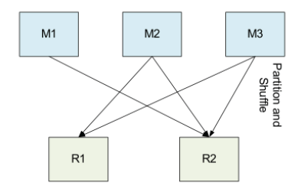
Sorting (cont’d)
Trivial with a single reducer
For multiple reducers, need to choose a partitioning function
such that if k1 < k2, partition(k1) <= partition(k2)

Slide 17
Sorting as a Speed Test of Hadoop
Sorting is frequently used as a speed test for a Hadoop cluster
Mapper and Reducer are trivial
Therefore sorting is effectively testing the Hadoop
framework’s I/O
Good way to measure the increase in performance if you enlarge your cluster
Run and time a sort job before and after you add more nodes
terasort is one of the sample jobs provided with Hadoop
Creates and sorts very large files

Slide 18
Searching
Assume the input is a set of files containing lines of text
Assume the Mapper has been passed the pattern for which to search as a special parameter
We saw how to pass parameters to your Mapper in the previous chapter
Algorithm:
Mapper compares the line against the pattern
If the pattern matches, Mapper outputs (line, _)
Or (filename+line, _), or …
If the pattern does not match, Mapper outputs nothing
Reducer is the Identity Reducer
Just outputs each intermediate key

Slide 19
Indexing
Assume the input is a set of files containing lines of text
Key is the byte offset of the line, value is the line itself

Slide 20
Inverted Index Algorithm
Mapper:
For each word in the line, emit (word, filename)
Reducer:
Identity function
Collect together all values for a given key (i.e., all filenames for a particular word)
Emit (word, filename_list)

Slide 21
Inverted Index: Dataflow
Page A
A map output
This: A
page : A
contains : A
so : A
much : A
text : A
This page contains so much text
Reduced output
contains : A,B
much : A
My : B
page : A,B
so : A
text : A,B
This : A
too : B
Page B
B map output
My : B
page : B
contains : B
text : B
Too : B
My page contains text too

Slide 22
Aside: Word Count
Recall the WordCount example we used earlier in the course
For each word, Mapper emitted (word, 1)
Very similar to the inverted index
This is a common theme: reuse of existing Mappers, with minor modifications

Slide 23
Joining Data Sets in MapReduce Jobs
How to write a Map-side join
How to implement the secondary sort
How to write a Reduce-side join

Slide 24
Joining Data Sets in MapReduce Jobs
Introduction
Map-Side Joins
The Secondary Sort
Reduce-Side Joins

Slide 25
Introduction
We frequently need to join data together from two sources as part of a MapReduce job, such as
Lookup tables
Data from database tables
There are two fundamental approaches: Map-side joins and Reduce-side joins
Map-side joins are easier to write, but have potential scaling issues
We will investigate both types of joins

Slide 26
But First…
But first…
Avoid writing joins in Java MapReduce if you can!
Abstractions such as Pig and Hive are much easier to use
Save hours of programming
If you are dealing with text-based data, there really is no reason not to use Pig or Hive

Slide 27
Joining Data Sets in MapReduce Jobs
Introduction
Map-Side Joins
The Secondary Sort
Reduce-Side Joins
Conclusion

Slide 28
Map-Side Joins: The Algorithm
Basic idea for Map-side joins:
Load one set of data into memory, stored in an associative array
Key of the associative array is the join key
Map over the other set of data, and perform a lookup on the associative array using the join key
If the join key is found, you have a successful join
Otherwise, do nothing

Slide 29
Map-Side Joins: Problems, Possible Solutions
Map-side joins have scalability issues
The associative array may become too large to fit in memory
Possible solution: break one data set into smaller pieces
Load each piece into memory individually, mapping over the second data set each time
Then combine the result sets together

Slide 30
Joining Data Sets in MapReduce Jobs
Introduction
Map-Side Joins
The Secondary Sort
Reduce-Side Joins
Conclusion

Slide 31
Secondary Sort: Motivation
Recall that keys are passed to the Reducer in sorted order
The list of values for a particular key is not sorted
Order may well change between different runs of the MapReduce job
Sometimes a job needs to receive the values for a particular key in a sorted order
This is known as a secondary sort

Slide 32
Implementing the Secondary Sort
To implement a secondary sort, the intermediate key should be a composite of the ‘actual’ (natural) key and the value
Define a Partitioner which partitions just on the natural key
Define a Comparator class which sorts on the entire composite key
Orders by natural key and, for the same natural key, on the value portion of the key
Ensures that the keys are passed to the Reducer in the desired order
Specified in the driver code by
conf.setOutputKeyComparatorClass(MyOKCC.class);

Slide 33
Implementing the Secondary Sort (cont’d)
Now we know that all values for the same natural key will go to the same Reducer
And they will be in the order we desire
We must now ensure that all the values for the same natural key are passed in one call to the Reducer
Achieved by defining a Grouping Comparator class which partitions just on the natural key
Determines which keys and values are passed in a single call to the Reducer.
Specified in the driver code by
conf.setOutputValueGroupingComparator(MyOVGC.class);

Slide 34
Secondary Sort: Example
Assume we have input with (key, value) pairs like this
foo 98
foo 101
bar 12
baz 18
foo 22
bar 55
baz 123
We want the Reducer to receive the intermediate data for each key in descending numerical order

Slide 35
Secondary Sort: Example (cont’d)
Write the Mapper such that they key is a composite of the natural key and value
For example, intermediate output may look like this:
('foo#98', 98)
('foo#101', 101)
('bar#12',12)
('baz#18', 18)
('foo#22', 22)
('bar#55', 55)
('baz#123', 123)

Slide 36
Secondary Sort: Example (cont’d)
Write a class that extends WritableComparator and sorts on natural key, and for identical natural keys, sorts on the value portion in descending order
Just override compare(WritableComparable, WritableComparable)
Supply a reference to this class in your driver using the JobConf.setOutputKeyComparatorClass method
Will result in keys being passed to the Reducer in this order:
('bar#55', 55)
('bar#12', 12)
('baz#123', 123)
('baz#18', 18)
('foo#101', 101)
('foo#98', 98)
('foo#22', 22)

Slide 37
Secondary Sort: Example (cont’d)
Finally, write another WritableComparator subclass which just examines the first portion of the key
Again, just override compare(WritableComparable, WritableComparable)
Supply a reference to this class in your driver using the
JobConf.setOutputValueGroupingComparator method
This will ensure that values associated with the same natural key will be sent to the same pass of the Reducer
But they’re sorted in descending order, as we required

Slide 38
Joining Data Sets in MapReduce Jobs
Introduction
Map-Side Joins
The Secondary Sort
Reduce-Side Joins
Conclusion

Slide 39
Reduce-Side Joins: The Basic Concept
For a Reduce-side join, the basic concept is:
Map over both data sets
Emit a (key, value) pair for each record
Key is the join key, value is the entire record
In the Reducer, do the actual join
Because of the Shuffle and Sort, values with the same key are brought together

Slide 40
Reduce-Side Joins: Example
Example input data:
EMP: 42, Aaron, loc(13)
LOC: 13, New York City
Required output:
EMP: 42, Aaron, loc(13), New York City

Slide 41
Example Record Data Structure
A data structure to hold a record could look like this:
class Record {
enum Typ { emp, loc };
Typ type;
String empName;
int empId;
int locId;
String locationName;
}

Slide 42
Reduce-Side Join: Mapper
void map(k, v) {
Record r = parse(v);
emit (r.locId, r);
}

Slide 43
Reduce-Side Join: Reducer
void reduce(k, values) {
Record thisLocation;
List<Record> employees;
for (Record v in values) {
if (v.type == Typ.loc) {
thisLocation = v;
} else {
employees.add(v);
}
}
for (Record e in employees) {
e.locationName = thisLocation.locationName;
emit(e);
}
}

Slide 44
Scalability Problems With Our Reducer
All employees for a given location must potentially be buffered in the Reducer
Could result in out-of-memory errors for large data sets
Solution: Ensure the location record is the first one to arrive at the Reducer
Using a Secondary Sort

Slide 45
A Better Intermediate Key
class LocKey {
boolean isPrimary;
int locId;
public int compareTo(LocKey k) {
if (locId == k.locId) {
return Boolean.compare(k.isPrimary, isPrimary);
} else {
return Integer.compare(locId, k.locId);
}
}
public int hashCode() {
return locId;
}
}

Slide 46
A Better Intermediate Key (cont’d)
class LocKey {
boolean isPrimary;
int locId;
public int compareTo(LocKey k) {
if (locId == k.locId) {
return Boolean.compare(k.isPrimary, isPrimary);
} else {
return Integer.compare(locId, k.locId);
}
}
public int hashCode() {
return locId;
}
}
The hashCode means that all records with the same
key will go to the same Reducer

Slide 47
A Better Intermediate Key (cont’d)
class LocKey {
boolean isPrimary;
int locId;
public int compareTo(LocKey k) {
if (locId == k.locId) {
return Boolean.compare(k.isPrimary, isPrimary);
} else {
return Integer.compare(locId, k.locId);
}
}
public int hashCode() {
return locId;
}
}
The compareTo method ensures that primary keys will
sort earlier than non-primary keys for the same location

Slide 48
A Better Mapper
void map(k, v) {
Record r = parse(v);
if (r.type == Typ.emp) {
emit (FK(r.locId), r);
} else {
emit (PK(r.locId), r);
}
}

Slide 49
A Better Reducer
Record thisLoc;
void reduce(k, values) {
for (Record v in values) {
if (v.type == Typ.loc) {
thisLoc = v;
} else {
v.locationName = thisLoc.locationName;
emit(v);
}
}
}

Slide 50
What Are Counters?
Counters provide a way for Mappers or Reducers to pass aggregate values back to the driver after the job has completed
Their values are also visible from the JobTracker’s Web UI
And are reported on the console when the job ends
Very basic: just have a name and a value
Value can be incremented within the code
Counters are collected into Groups
Within the group, each Counter has a name
Example: A group of Counters called RecordType
Names: TypeA, TypeB, TypeC
Appropriate Counter will be incremented as each record is read in the Mapper

Slide 51
What Are Counters? (cont’d)
Counters provide a way for Mappers or Reducers to pass aggregate values back to the driver after the job has completed
Their values are also visible from the JobTracker’s Web UI
Counters can be set and incremented via the method
Reporter.incrCounter(group, name, amount);
Example
r.incrCounter("RecordType", "TypeA", 1);

Slide 52
Retrieving Counters in the Driver Code
To retrieve Counters in the Driver code after the job is complete, use code like this:
RunningJob job = JobClient.runJob(conf);
long typeARecords =
job.getCounters().findCounter("RecordType", "TypeA").getValue();
long typeBRecords =
job.getCounters().findCounter("RecordType", "TypeB").getValue();

Slide 53
Counters: Caution
Do not rely on a counter’s value from the Web UI while a job is running
Due to possible speculative execution, a counter’s value could appear larger than the actual final value
Modifications to counters from subsequently killed/failed tasks will be removed from the final count

Slide 54
Map-Only MapReduce Jobs
There are many types of job where only a Mapper is needed
Examples:
Image processing
File format conversion
Input data sampling
ETL

Slide 55
Creating Map-Only Jobs
To create a Map-only job, set the number of Reducers to 0 in your Driver code
Anything written using the OutputCollector.collect method will be written to HDFS
Rather than written as intermediate data
One file per Mapper will be written
conf.setNumReduceTasks(0);

Slide 56
More Advanced MapReduce Programming
Creating InputFormats and OutputFormats

Slide 57
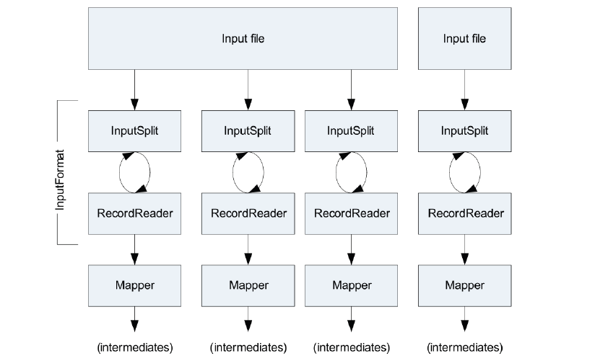
Recap: Inputs to Mappers

Slide 58
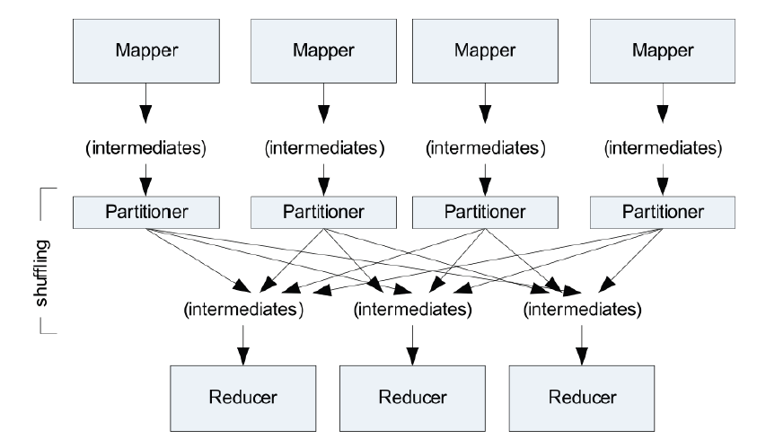
Recap: Sort and Shuffle

Slide 59
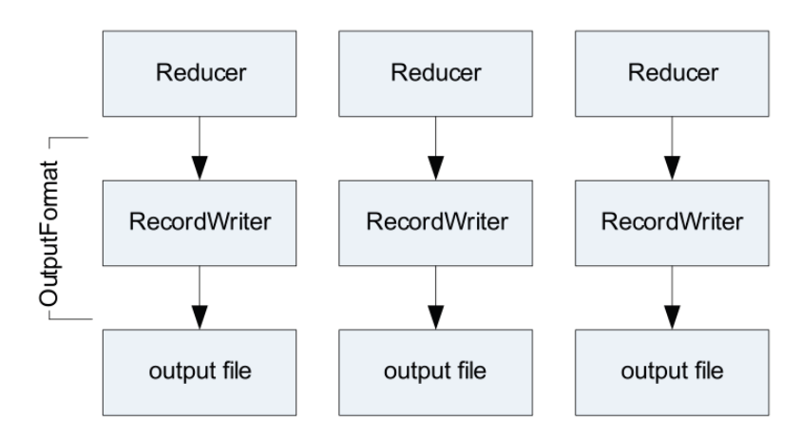
Recap: Reducers to Outputs

Slide 60
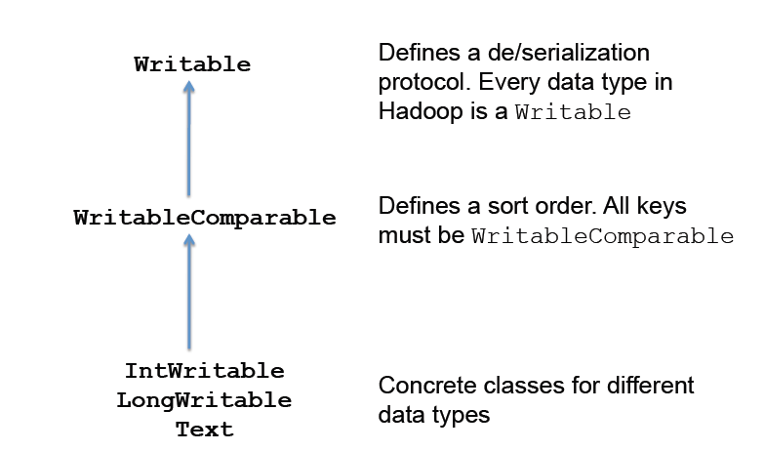
Data Types in Hadoop

Slide 61
‘Box’ Classes in Hadoop
Hadoop data types are ‘box’ classes
Text: string
IntWritable: int
LongWritable: long
FloatWritable: float
…
Writable defines wire transfer format

Slide 62
Creating a Complex Writable
Example: say we want a tuple (a, b)
We could artificially construct it by, for example, saying
Inelegant
Problematic
If a or b contained commas
Not always practical
Doesn’t easily work for binary objects
Text t = new Text(a + "," + b);
...
String[] arr = t.toString().split(",");

Slide 63
The Writable Interface
public interface Writable {
void readFields(DataInput in);
void write(DataOutput out);
}
DataInput/DataOutput supports
boolean
byte, char (Unicode: 2 bytes)
double, float, int, long,
String (Unicode or UTF-8)
Line until line terminator
unsigned byte, short
byte array

Slide 64
Example: 3D Point Class
class Point3d implements Writable {
float x, y, z;
void readFields(DataInput in) {
x = in.readFloat();
y = in.readFloat();
z = in.readFloat();
}
void write(DataOutput out) {
out.writeFloat(x);
out.writeFloat(y);
out.writeFloat(z);
}
}

Slide 65
What About Binary Objects?
Solution: use byte arrays
Write idiom:
Serialize object to byte array
Write byte count
Write byte array
Read idiom:
Read byte count
Create byte array of proper size
Read byte array
Deserialize object

Slide 66
WritableComparable
WritableComparable is a sub-interface of Writable
Must implement compareTo, hashCode, equals methods
All keys in MapReduce must be WritableComparable

Slide 67
Example: 3D Point Class
class Point3d implements WritableComparable {
float x, y, z;
void readFields(DataInput in) {
x = in.readFloat();
y = in.readFloat();
z = in.readFloat();
}
void write(DataOutput out) {
out.writeFloat(x);
out.writeFloat(y);
out.writeFloat(z);
}
public int compareTo(Point3d p) {
// whatever ordering makes sense ... (e.g., closest to origin)
}
public boolean equals(Object o) {
Point3d p = (Point3d) o;
return this.x == p.x && this.y == p.y && this.z == p.z;
}
public int hashCode() {
// whatever makes sense ...
}
}

Slide 68
Comparators to Speed Up Sort and Shuffle
Recall that after each Map task, Hadoop must sort the keys
Keys are passed to a Reducer in sorted order
Naïve approach: use the WritableComparable’s compareTo method for each key
This requires deserializing each key, which could be time consuming
Better approach: use a Comparator
A class which can compare two WritableComparables, ideally just by looking at the two byte streams
Avoids the need for deserialization, if possible
Not always possible; depends on the actual key definition

Slide 69
Example Comparator for the Text Class
public class Text implements WritableComparable {
...
public static class Comparator extends WritableComparator {
public Comparator() {
super(Text.class);
}
public int compare(byte[] b1, int s1, int l1, byte[] b2, int s2, int l2)
{
int n1 = WritableUtils.decodeVIntSize(b1[s1]);
int n2 = WritableUtils.decodeVIntSize(b2[s2]);
return compareBytes(b1, s1+n1, l1-n1, b2, s2+n2, l2-n2);
}
}
...
static {
// register this comparator
WritableComparator.define(Text.class, new Comparator());
}
}

Slide 70
Using Custom Types in MapReduce Jobs
Use methods in JobConf to specify your custom key/value types
For output of Mappers:
For output of Reducers:
Input types are defined by InputFormat
See later
conf.setMapOutputKeyClass()
conf.setMapOutputValueClass()
conf.setOutputKeyClass()
conf.setOutputValueClass()

Slide 71
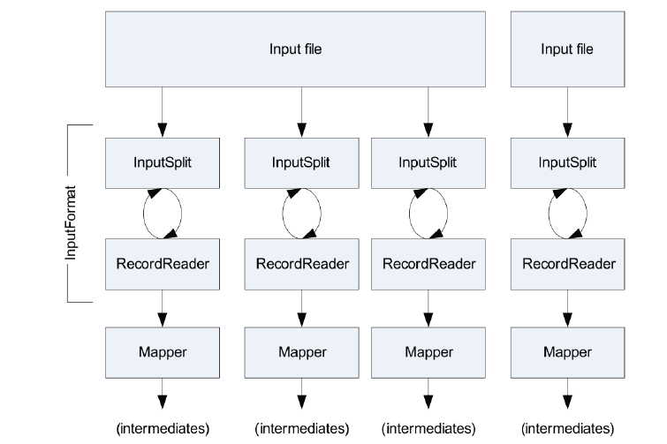
Reprise: The Role of the InputFormat

Slide 72
Most Common InputFormats
Most common InputFormats:
TextInputFormat
KeyValueTextInputFormat
SequenceFileInputFormat
Others are available
NLineInputFormat
Every n lines of an input file is treated as a separate InputSplit
Configure in the driver code with
MultiFileInputFormat
Abstract class which manages the use of multiple files in a single task
You must supply a getRecordReader() implementation
mapred.line.input.format.linespermap

Slide 73
How FileInputFormat Works
All file-based InputFormats inherit from FileInputFormat
FileInputFormat computes InputSplits based on the size of each file, in bytes
HDFS block size is used as upper bound for InputSplit size
Lower bound can be specified in your driver code
Important: InputSplits do not respect record boundaries!

Slide 74
What RecordReaders Do
InputSplits are handed to the RecordReaders
Specified by the path, starting position offset, length
RecordReaders must:
Ensure each (key, value) pair is processed
Ensure no (key, value) pair is processed more than once
Handle (key, value) pairs which are split across InputSplits

Slide 75
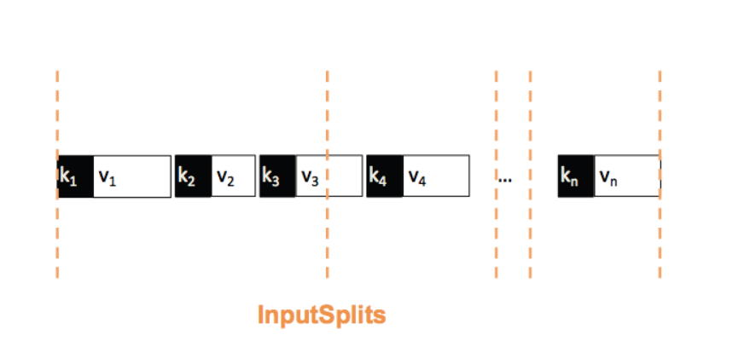
Sample InputSplit

Slide 76
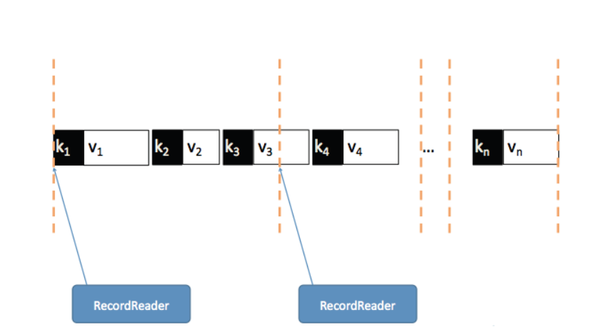
From InputSplits to RecordReaders

Slide 77
Writing Custom InputFormats
Use FileInputFormat as a starting point
Extend it
Write your own custom RecordReader
Override getRecordReader method in FileInputFormat
Override isSplittable if you don’t want input files to be split

Slide 78
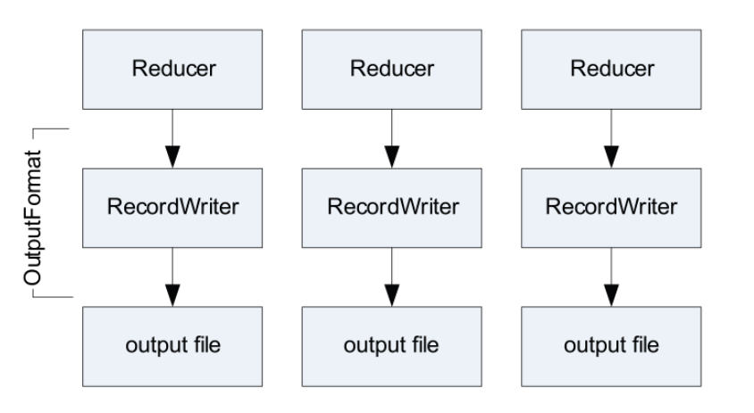
Reprise: Role of the OutputFormat

Slide 79
OutputFormat
OutputFormats work much like InputFormat classes
Custom OutputFormats must provide a RecordWriter implementation

Slide 80
The Combiner
Often, Mappers produce large amounts of intermediate data
That data must be passed to the Reducers
This can result in a lot of network traffic
It is often possible to specify a Combiner
Like a ‘mini-Reducer’
Runs locally on a single Mapper’s output
Output from the Combiner is sent to the Reducers
Combiner and Reducer code are often identical
Technically, this is possible if the operation performed is commutative and associative
In this case, input and output data types for the Combiner/ Reducer must be identical

Slide 81
MapReduce Example: Word Count
To see how a Combiner works, let’s revisit the WordCount
example we covered earlier
map(String input_key, String input_value)
foreach word w in input_value:
emit(w, 1)
reduce(String output_key,
Iterator<int> intermediate_vals)
set count = 0
foreach v in intermediate_vals:
count += v
emit(output_key, count)

Slide 82
MapReduce Example: Word Count (cont’d)
Input to the Mapper:
(3414, 'the cat sat on the mat')
(3437, 'the aardvark sat on the sofa')
Output from the Mapper:
('the', 1), ('cat', 1), ('sat', 1), ('on', 1),
('the', 1), ('mat', 1), ('the', 1), ('aardvark', 1),
('sat', 1), ('on', 1), ('the', 1), ('sofa', 1)

Slide 83
MapReduce Example: Word Count (cont’d)
Intermediate data sent to the Reducer:
('aardvark', [1])
('cat', [1])
('mat', [1])
('on', [1, 1])
('sat', [1, 1])
('sofa', [1])
('the', [1, 1, 1, 1])
Final Reducer output:
('aardvark', 1)
('cat', 1)
('mat', 1)
('on', 2)
('sat', 2)
('sofa', 1)
('the', 4)

Slide 84
Word Count With Combiner
A Combiner would reduce the amount of data sent to the Reducer
Intermediate data sent to the Reducer after a Combiner using the same code as the Reducer:
('aardvark', [1])
('cat', [1])
('mat', [1])
('on', [2])
('sat', [2])
('sofa', [1])
('the', [4])
Combiners decrease the amount of network traffic required during the shuffle and sort phase
Often also decrease the amount of work needed to be done by the Reducer

Slide 85
Specifying a Combiner
To specify the Combiner class to be used in your MapReduce code, put the following line in your Driver:
conf.setCombinerClass(YourCombinerClass.class);
The Combiner uses the same interface as the Reducer
Takes in a key and a list of values
Outputs zero or more (key, value) pairs
The actual method called is the reduce method in the class
VERY IMPORTANT: Never put code in the Combiner that must be run as part of your MapReduce job
The Combiner many not be run on the output from some or all of the Mappers

Slide 86
What Does The Partitioner Do?
The Partitioner divides up the keyspace
Controls which Reducer each intermediate key and its associated values goes to
Often, the default behavior is fine
Default is the HashPartitioner
public class HashPartitioner<K2, V2> implements Partitioner<K2, V2> {
public void configure(JobConf job) {}
public int getPartition(K2 key, V2 value,
int numReduceTasks) {
return (key.hashCode() & Integer.MAX_VALUE) % numReduceTasks;
}
}

Slide 87
Custom Partitioners
Sometimes you will need to write your own Partitioner
Example: your key is a custom WritableComparable which contains a pair of values (a, b)
You may decide that all keys with the same value for a need to go to the same Reducer
The default Partitioner is not sufficient in this case

Slide 88
Custom Partitioners (cont’d)
Custom Partitioners are needed when performing a secondary sort
Custom Partitioners are also useful to avoid potential performance issues
To avoid one Reducer having to deal with many very large lists of values
Example: in our word count job, we wouldn't want a single reduce dealing with all the three- and four-letter words, while another only had to handle 10- and 11-letter words

Slide 89
Creating a Custom Partitioner
To create a custom partitioner:
Create a class for the partitioner
Should implement the Partitioner interface
Create a method in the class called getPartition
Receives the key, the value, and the number of Reducers
Should return an int between 0 and one less than the number of Reducers
e.g., if it is told there are 10 Reducers, it should return an int between 0 and 9
Specify the custom partitioner in your driver code
conf.setPartitionerClass(MyPartitioner.class);

Slide 90
The Distributed Cache: Motivation
A common requirement is for a Mapper or Reducer to need access to some ‘side data’
Lookup tables
Dictionaries
Standard configuration values
One option: read directly from HDFS in the configure method
Works, but is not scalable
The DistributedCache provides an API to push data to all slave nodes
Transfer happens behind the scenes before any task is executed
Note: DistributedCache is read-only
Files in the DistributedCache are automatically deleted from slave nodes when the job finishes

Slide 91
Using the DistributedCache: The Difficult Way
Place the files into HDFS
Configure the DistributedCache in your driver code
JobConf job = new JobConf();
DistributedCache.addCacheFile(new URI("/myapp/lookup.dat"), job);
DistributedCache.addFileToClassPath(new Path("/myapp/mylib.jar"), job);
DistributedCache.addCacheArchive(new URI("/myapp/map.zip", job);
DistributedCache.addCacheArchive(new URI("/myapp/mytar.tar", job);
DistributedCache.addCacheArchive(new URI("/myapp/mytgz.tgz", job);
DistributedCache.addCacheArchive(new URI("/myapp/mytargz.tar.gz", job);
.jar files added with addFileToClassPath will be added to your Mapper or Reducer’s classpath
Files added with addCacheArchive will automatically be dearchived/decompressed

Slide 92
Using the DistributedCache: The Easy Way
If you are using ToolRunner, you can add files to the DistributedPath directly from the command line when you run the job
No need to copy the files to HDFS first
Use the -files option to add files
hadoop jar myjar.jar MyDriver -files file1, file2, file3, ...
The -archives flag adds archived files, and automatically unarchives them on the destination machines
The -libjars flag adds jar files to the classpath

Slide 93
Accessing Files in the DistributedCache
Files added to the DistributedCache are made available in your task’s local working directory
Access them from your Mapper or Reducer the way you would read any ordinary local file
File f = new File("file_name_here");

